Slide 1
Pneumonia Detection using CNN and Transfer Learning
Ayyappan K M - 19BCE1410
Bollineni Nishanth - 19BCE1805

Slide 2
INTRODUCTION
Pneumonia is a respiratory infection caused by bacteria or viruses; it affects many individuals, especially in developing and underdeveloped nations, where high levels of pollution, unhygienic living conditions, and overcrowding are relatively common, together with inadequate medical infrastructure.
Pneumonia causes pleural effusion, a condition in which fluids fill the lung, causing respiratory difficulty. Early diagnosis of pneumonia is crucial to ensure curative treatment and increase survival rates.
Chest X-ray imaging is the most frequently used method for diagnosing pneumonia. However, the examination of chest X-rays is a challenging task and is prone to subjective variability.

Slide 3
Challenges with manual detection
Accurately diagnosing pneumonia is a tall order. It requires review of a chest radiograph (CXR) by highly trained specialists and confirmation through clinical history, vital signs and laboratory exams.
Pneumonia usually manifests as an area or areas of increased opacity on CXR(Chest X-Ray).
With the rise in medical problems such as cough, fever and chest pains especially during the pandemic period, there might be a shortage of skilled physicians to examine and analyse the CXR to determine any medical conditions.

Slide 4
Why did we use AI in our project
Artificially intelligent computer systems are used extensively in medical sciences. Common applications include diagnosing patients, end-to-end drug discovery and development, improving communication between physician and patient, transcribing medical documents, etc.
Hence the use of AI to read, analyse and determine if there is any underlying medical condition from an Chest X-Ray will be highly beneficial to the medical community and help in the advancement of medical sciences.

Slide 5
PEAS Description
The PEAS system delivers the performance measure with respect to the environment, actuators and sensors of the respective agent.
When we define an AI agent or rational agent, then we group its properties under PEAS representation model
P - Performance Measure
E - Environment
A - Actuators
S - Sensors

Slide 6
PEAS Model for our project
Performance Measure - minimize X-Ray analysis time, Reduce patient waiting time for results
Environment - Hospital, Patient, Customer, Doctor
Actuators - Screen to Display Results
Sensors - Keyboard, mouse to upload X-Ray

Slide 7
Features and Classifiers
Initially we plan to implement CNN for both feature extraction and model building to predict if a given Chest X-Ray has the signs of pneumonia or not.
Based on the results obtained we will decide if we require any other ML model such as random forest or SVM to support the classifier and gain a better accuracy score.

Slide 8
Proposed Methodology
We plan to build a fully functional Web Application where a person or patient can upload his/her Chest X-Ray and the output would be if he/she has pneumonia or not.
The backend ML model which is CNN would take this input into the already trained model and predict the output.
We will be using Flask as our frontend framework to implement this.

Slide 9
Transfer Learning
Transfer learning is a machine learning method where a model developed for a task is reused as the starting point for a model on a second task.
It is a popular approach in deep learning where pre-trained models are used as the starting point on computer vision and natural language processing tasks given the vast compute and time resources required to develop neural network models on these problems and from the huge jumps in skill that they provide on related problems

Slide 10
DenseNet and ResNet
A DenseNet is a type of convolutional neural network that utilises dense connections between layers, through Dense Blocks, where we connect all layers (with matching feature-map sizes) directly with each other.
To preserve the feed-forward nature, each layer obtains additional inputs from all preceding layers and passes on its own feature-maps to all subsequent layers.
The problem of training very deep networks has been relieved with the introduction of these Residual blocks and the ResNet model is made up of these blocks.

Slide 11
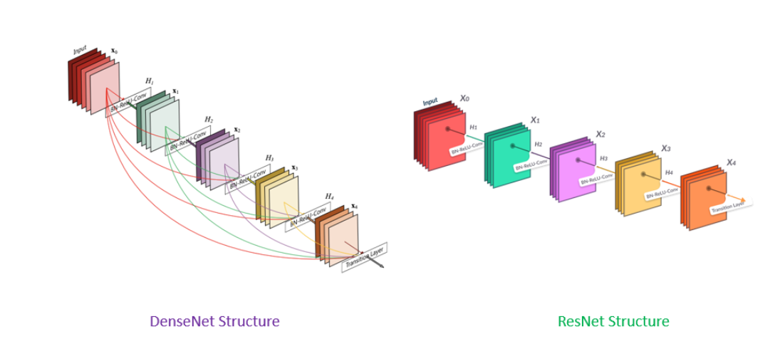

Slide 12
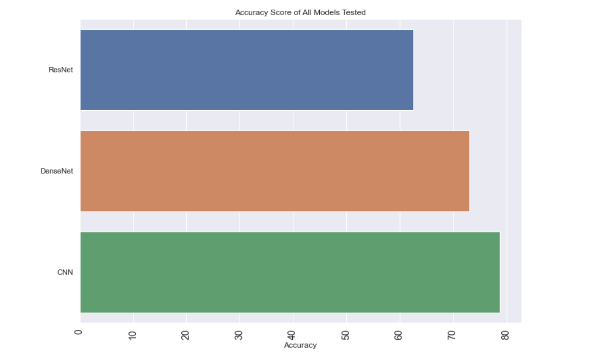
Results

Slide 13
References
https://ieeexplore.ieee.org/document/8869364
https://journals.plos.org/plosone/article?id=10.1371/journal.pone.0256630

